Slide 1
Siyenza Definitions
June 26, 2019

Slide 2



Siyenza Definitions
 | Siyenza | DSD+ | TA (Technical Assistance)
Definition | Facilities receive direct service delivery (DSD) support from PEPFAR, including provision of key staff or commodities & support to improve the quality of services through site visits. This includes weekly site visit support and technical assistance from NDOH, PEPFAR, and partners. | Facilities receive direct service delivery (DSD) support from PEPFAR, including provision of key staff or commodities & support to improve the quality of services through site visits. This includes regular site visit support and technical assistance from partners. | Facilities will receive support from PEPFAR to improve the quality of services. This includes quarterly visits from partners. No HRH or commodities will be provided to the facility.
Notes:
Add 343

Slide 3
System Siyenza Indicators
June 27, 2019

Slide 4
Rationale: HPRS Indicators
The NDoH circular mandated full utilization of the HPRS system
However, there has been limited site-level monitoring of HPRS within the Siyenza framework to ensure that the system is functional and fully utilized
Collecting data from the HPRS system on the number of facility visits recorded within the weekly reporting period will serve as the numerator of the HPRS coverage indicator
Collecting data on weekly facility headcount will serve as the denominator of the HPRS coverage indicator

Slide 5
Definitions, Frequency, Methodology
New Indicators | Frequency of Reporting | Definitions | Reporting Methodology
HEADCOUNT | Weekly (Friday) | Number of visits at the facility for health services for the reporting period of 1 week. | Source: Routine data source for reporting on headcount (paper headcount Register/HPRS/etc.) Steps: 1. Count the number of patients who visited the facility during the reporting week (Saturday to Friday)
HPRS_VISITS | Weekly (Friday) | Number of visits logged in the HPRS system for the reporting period of 1 week. | Source: HPRS System Steps: 1. Go to Reporting 2. Select facility reports 3. Select Visits to facility 4. Enter period for the reporting week (Saturday-Friday)

Slide 6
Rationale- CCMDD Indicators
The NDoH circular focused on expanding the supply of external pick up points to increase the rate of decanting from facility based care through the CCMDD program
However, there has been limited site-level monitoring of decanting rates to ensure that patients who are eligible are being informed of their decanting options and enrolled in the program accordingly
Collecting data on new CCMDD enrollments will allow us to monitor the CCMDD growth rate at facility-level
Disaggregating CCMDD enrollments by the manual paper process and by registrations utilizing the electronic Synchronized National Communication in Health (SyNCH) system will allow us to monitor SyNCH system utilization and address data quality challenges

Slide 7
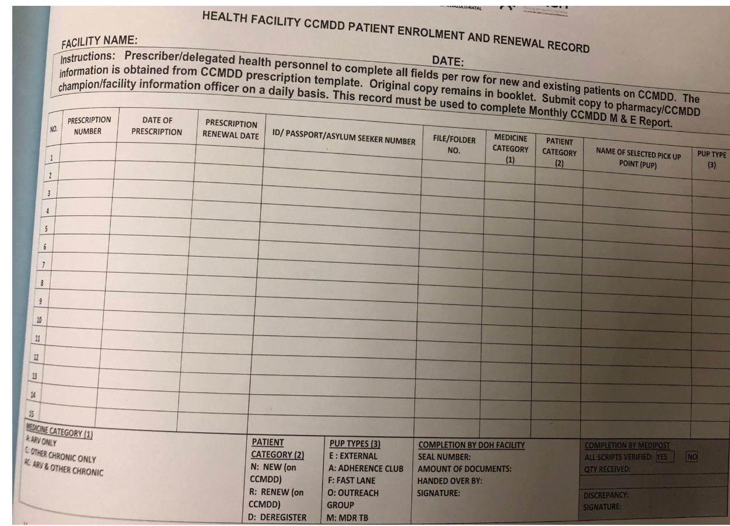
Example of a Register in Ethekwini

Slide 8
Definitions, Frequency, Methodology
New Indicators | Frequency of Reporting | Definitions | Reporting Methodology
CCMDD_TIER | Weekly (Friday) | Number of patients newly enrolled for CCMDD in the TIER.net system for the reporting period of 1 week. This is a quality check indicator, and is NOT the sum of MANUAL & SYNCH. Note that this is inclusive only of those receiving their drugs through a script fulfilled by an external service provider at a CCMDD pick up point (internal/external) and excludes adherence clubs/space fast lanes.* *This will be revisited pending revisions to how CCMDD is recorded in Tier.net in October 2020 | Source: CCMDD List Steps: 1. Generate the CMMDD List in TIER.NET (Analysis-->HIV Reports and Lists--> CCMDD List) 2. Count patients with an enrollment date within the reporting period (Saturday=Friday). 3. Verify if the patient is newly registered or re-registered Additional Resources: Instructions to make CMMDD list filterable
CCMDD_MANUAL | Weekly (Friday) | Number of paper logs counted from new CCMDD enrollment (at an internal/external pick up point) for the reporting period of 1 week. | Source: CCMDD Registers/ CCMDD Prescription Books* Steps: 1. Count all CMMD paper logs/ scripts done for the reporting week (Saturday-Friday), excluding the repeat prescriptions *These likely vary by geography and DSP and are used for CCMDD M&E. Further SOPs to be developed tailored to each district
CCMDD_SYNCH | Weekly (Friday) | Number of patients newly enrolled for CCMDD (internal/external pick up point) in the SyNCH system, generated from SyNCH for the reporting period of 1 week. Note that the full generation of the script in SyNCH by the clinician must be implemented. | Source: SYNCH System Steps: 1.Log in 2. Go to Prescription 3. Manage Prescription next page view all clients 4. Select fully dispensed 5. See records--> go to records--> view all clients on CCMDD. 6. Check the last prescriptions date of each client. 7. Count all newly enrolled CCMDD clients for the reporting week (Saturday-Friday).

Slide 9
NDOH Circular

Slide 10
Summary of Circular Content – Draft from June 22
Accountability at all levels
DOH site staff
Operations Managers
District and Provincial HAST managers
Provincial Project Management structures
Provinces and Districts must adopt targets and have consumables and materials to meet them—no stock outs
Facilities must adopt a patient-centered approach
Must offer interventions for young men aged 15-24 years, and men aged 25 years +, AGYW, and Children <15 years
Increases in: same day ART, TPT, facilities offering extended hours, mobile services, decanting (85% target of eligibles), reduced waiting times through apt system/pre-retreival

Slide 11

Thank You!

